Slide 1
UE17CS490A – Capstone Project Phase – 1
Project Progress Review #2
(Project Requirements Specification and Literature Survey)
Project Title : Extracting and Rendering 3D Structure and Orientation of Objects From 2D Images
Project ID : PW21KS03 (3_129_276_1525)
Project Guide : Prof. K. S. Srinivas
Project Team : Ashwin R Bharadwaj PES1201700003
Hardik Gourisaria PES1201700129
Hrishikesh V PES1201700276
K. Shrinidhi Bhagavath PES1201701525

Slide 2
Abstract and Scope
Rendering 3D structure of real world objects using only 2D images of the object without the aid of any special sensors such as the Kinect sensor.
Applications include:
3D printing real world objects based on images
Landscape simulations for AR and VR.
Improve human interaction of automation robots by helping them navigate and interact better with their surroundings

Slide 3
Abstract and Scope
Abstract:
Extraction of spatial orientation and geometric structure of objects and landscapes from 2D images to render the structure in 3D space to aid in various application in the field of Virtual and Augmented Reality

Slide 4
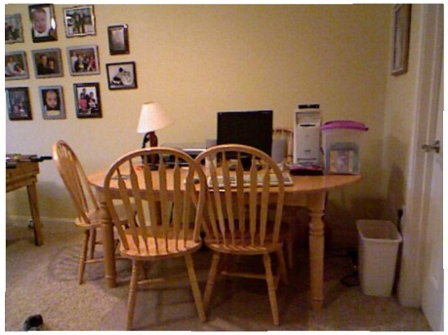
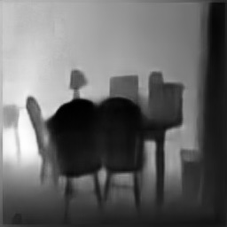
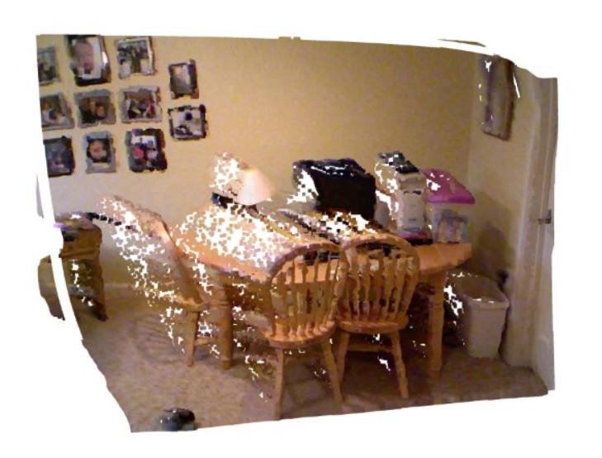
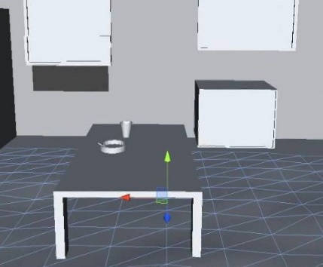
Abstract and Scope
Depth Map(s)
Input Image(s)
Depth Map(s)
Generate Solid 3D Objects/Landscapes
(Optimistic Goal)
Generate Point Cloud

Slide 5
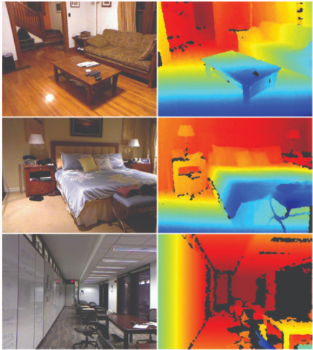
Suggestions from Review - 1
Datasets were recommended in the Review 1
NYU Depth dataset v2
DIML RGB+D dataset

Slide 6
User Classes and Characteristics
Architects may use the product to model a room in 3D space using only 2D images and make changes to the 3D model as desired
3D print real world objects based on images
Landscape simulations for AR and VR for devising military simulations and strategy
Improve human interaction of automation robots by helping them navigate and interact better with their surroundings

Slide 7
Constraints / Dependencies / Assumptions
Hardware Dependency:
Machines with good Graphics Processing Unit (GPU)
Good amount of RAM
Rent cloud GPUs for the above hardware requirements
Assumption:
We assume that one of the Deep Learning methods being explored will provide us good results.

Slide 8
Functional Requirements
Takes 2D RGB images as inputs
Convert 2D RGB image to 2D Grayscale image
Generates the Depth Map for the 2D image input
Uses the generated Depth Map for the 2D images to generate a 3D point cloud

Slide 9
Non - Functional Requirements
Model developed should be light weight and have low latency
Model should not have any hardware dependency
Model developed should work across multiple platforms and should be portable

Slide 10
Literature Survey
Zhao, Chaoqiang & Sun, Qiyu & Zhang, Chongzhen & Tang, Yang & Qian, Feng. (2020). Monocular Depth Estimation Based On Deep Learning: An Overview.
Main Idea:
Analyses and compares various Monocular Depth Estimation Techniques
Pros:
Introduction and summary to multiple techniques that can be explored

Slide 11
Literature Survey
Wofk, Diana and Ma, Fangchang and Yang, Tien-Ju and Karaman, Sertac and Sze, Vivienne, “FastDepth: Fast Monocular Depth Estimation on Embedded Systems,” in IEEE International Conference on Robotics and Automation (ICRA), 2019
Main Idea:
Using Mobile Net as an encoder to build a lightweight efficient model to obtain depth map for 2D images.
Pros:
Developed a lightweight model to generate depth map for 2D images
Cons:
Accuracy of the model reduces (MSE increases)

Slide 12
Literature Survey
K. G. Lore, K. Reddy, M. Giering, and E. Bernal, “Generative adversarial networks for depth map estimation from RGB video,” pp. 1258–12588,06 2018
Main Idea:
Using Optical Flow of the images to generate a Depth Map using Conditional GAN.
Pros:
Improved the accuracy on existing GAN based models
Cons:
Used very limited dataset and there is high chance of overfitting
No guarantee that the model will generalize well

Slide 13
Literature Survey
J. Facil, B. Ummenhofer, H. Zhou, L. Montesano, T. Brox, and J. Civera, “Cam-convs: Camera-aware multi-scale convolutions for single-view depth,” 04 201
Main Idea:
Using Camera Parameters to improve the accuracy of the Depth Map generated by the Deep Learning Model
Pros:
Model generalizes well across images captures using different cameras.

Slide 14
Literature Survey
S. Sabour, N. Frosst, and G. E. Hinton, “Dynamic routing between capsules,” 2017.
X. Luo, J.-B. Huang, R. Szeliski, K. Matzen, and J. Kopf, “Consistent video depth estimation,” 2020.
V. Harman, J. Flack, S. Fox, and M. Dowley, “Rapid 2d-to-3d conversion,” in Stereoscopic displays and virtual reality systems IX, vol. 4660, pp. 78–86, International Society for Optics and Photonics, 2002.

Slide 15
Literature Survey
Y. Zhao, T. Birdal, H. Deng, and F. Tombari, “3d point capsule networks,” in Proceedings of the IEEE conference on computer vision and pattern recognition, pp. 1009–1018, 2019.
L. Zhang, M. Edraki, and G.-J. Qi, “Cappronet: Deep feature learning via orthogonal projections onto capsule subspaces,” in Advances in Neural Information Processing Systems, pp. 5814–5823, 2018.
R. Saqur and S. Vivona, “Capsgan: Using dynamic routing for generative adversarial networks,” 2018.

Slide 16
Literature Survey
X.-F. Han*, H. Laga*, M. B. S. Member, and IEEE, “Image-based 3d object reconstruction: State-of-the-art and trends in the deep learning era,” arXiv preprint arXiv:1906.06543, 2019.
H. Xie, H. Yao, X. Sun, S. Zhou, S. Zhang, H. I. of Technology, S. Re-search, and P. C. Laboratory, “Pix2vox: Context-aware 3d reconstruction from single and multi-view images,” arXiv preprint arXiv:1901.11153v2, 2019.

Slide 17
Literature Survey
Z. Li and N. Snavely. Megadepth: Learning single-view depth prediction from internet photos. In Computer Vision and Pattern Recognition (CVPR), 2018
Y. Kuznietsov, J. St ̈uckler, and B. Leibe. Semi-supervised deep learning for monocular depth map prediction. In Proc.of the IEEE Conference on Computer Vision and Pattern Recognition, pages 6647–6655, 201
C. Godard, O. Mac Aodha, and G. Brostow. Digging into self-supervised monocular depth estimation. arXiv preprintarXiv:1806.01260, 2018

Slide 18
Progress So Far
Model Structure:
Auto Encoder-Decoder CNN with Skip Level Connections (U-Net) to preserve shape edges and features
Optimizer:
Adam Optimizer
Learning rate = 0.002 Alpha = 0.5
Loss Function Tries:
MSE, MAE, Berhu Function
Input and Output:
2D single channel grayscale image to Single channel depth map

Slide 19
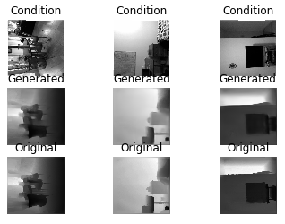
Progress So Far

Slide 20
Thank You

